Slide 1

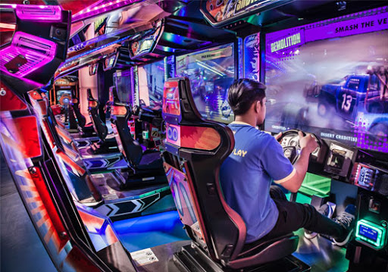
DBMS Project
TOPIC : FUN.GAMEZONE
GIVEN BY :
SUJEET KUMAR
VIKAS

Slide 2
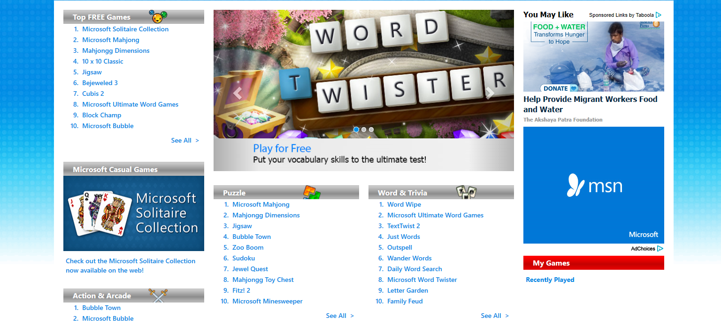
WEBSITE
INFORMATIONS.
REGISTRATION.
LOGIN : IF ACCOUNT EXIST
GAME ZONE : LINK.
GAME REVIEWS.
FREE & PAID GAMES.
GAME DOWNLOAD LINKS.

Slide 3

Files & technologies
HTML FILES
JS FILES
PHP FILES
XAMPP
SQL PLUS

Slide 4
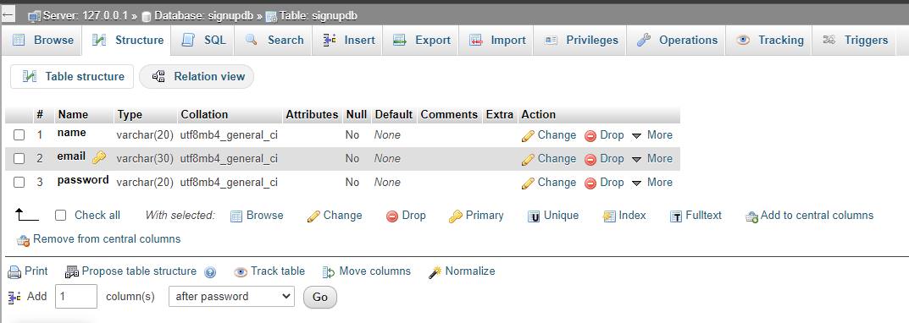
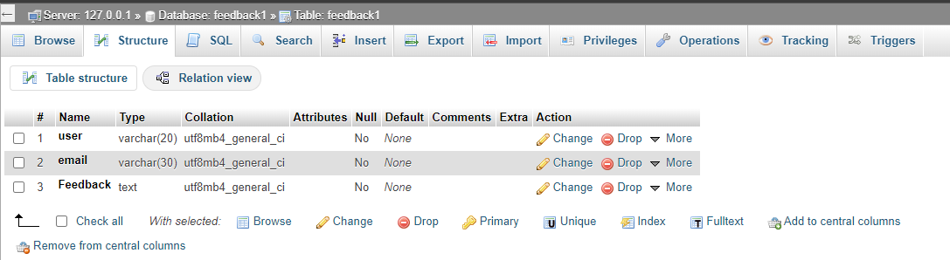
Tables
Sign Up Table :
Contact Table :

Slide 5
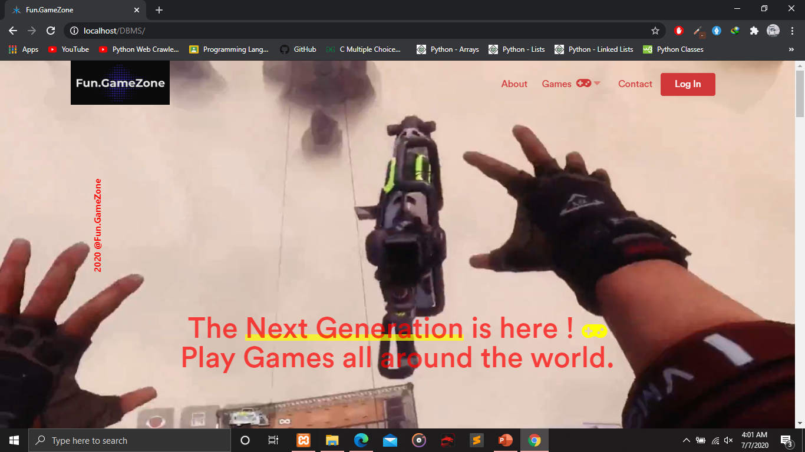
Website first look
Website first look
Fully Animated
Proper designed
Everything “In & Only One”

Slide 6

Team works
Combined works by both member’s.
Each part done and share together.

Slide 7
Working
REGISTRATION
LOGIN
PLAY
Can play any game only if you have registered in it.
NAME : Fun.gamezone
Can download any free games.

Slide 8
References
IDEAS :
TRIVAGO
RED BUS
91 MOBILE
WORKING :
Every games from everywhere.
Shorted by “Most Popular”
ONE WAY LOG-IN.

Slide 9
Future purposes
Can be use for Gaming Industries.
Partnership with Gaming Companies.
Register and Play.

Slide 10

IMProvements
Can be improved more.
Regarding publics demands.
Transection’s can be also be done.

